Slide 1
Protein Pow(d)er
Programmeertheorie, Week 1, Presenteersessie 1
Team: Shire Peasants 3
Authors: Mark Dzoljic, Loek van Steijn, Sebastiaan Kruize

Slide 2
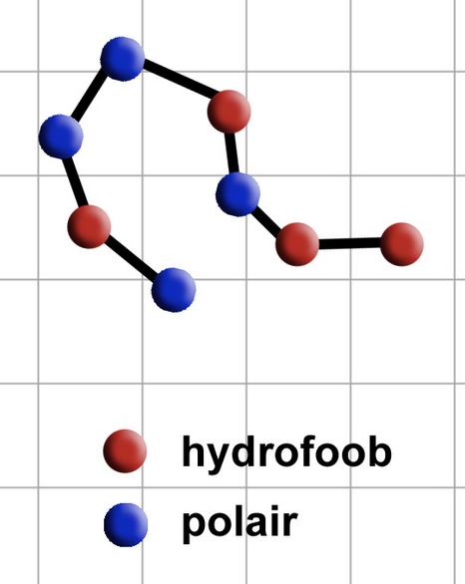
Case 3: Folding proteins
Proteins regulate many important processes in the human body
Consist of strings of amino-acids, which can either be Hydrophobic(H) or Polair (P)
A protein is stable depending on it’s structure (the way it is folded)
Stable proteins are important for the creation of new medicines or farmaceutical improvements.

Slide 3
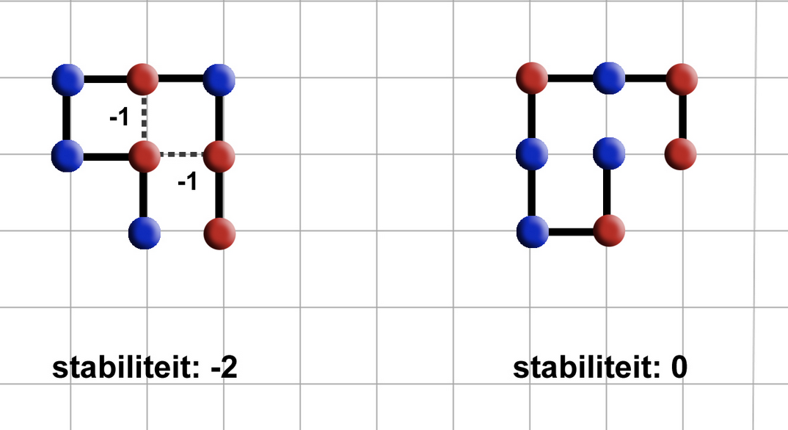
Stability of proteins
The more hydrophobic amino-acids (red) are next to each other, the more stable it is
Stability of 0 means unstable
Stability of -2 means more stable.
Goal is to find protein structures that are as stable as possible.

Slide 4
Calculating ‘optimal fold’
Example expected output table:
Step 1: Take a string of amino-acids, such as ‘HHPHPHHP’
Step 2: Lay it on a 2-D grid
Step 3: Fold the string so that it is as stable as possible
Step 4: generate output
amino, fold
H, 1
H, 2
P, -1
H, -1
P, 2
P, 2
P, 1
P, -2
H, 0

Slide 5
First steps
2 Heuristic problems:
Optimal way to store data
Optimal way to calculate optimal fold
Focus primarily on the first problem
3 methods:
Using a Matrix
Using a Dictionary
Using OOP

Slide 6
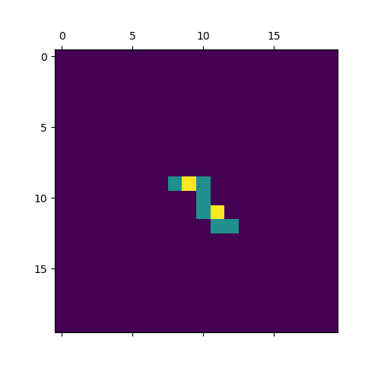
Using a Matrix
H is blue, P is yellow
Elements get numerical value
Spawn first element somewhere in the middle
Chain other elements randomly and self-avoidingly
Save moves made and occupied ‘tiles’ in list

Slide 7
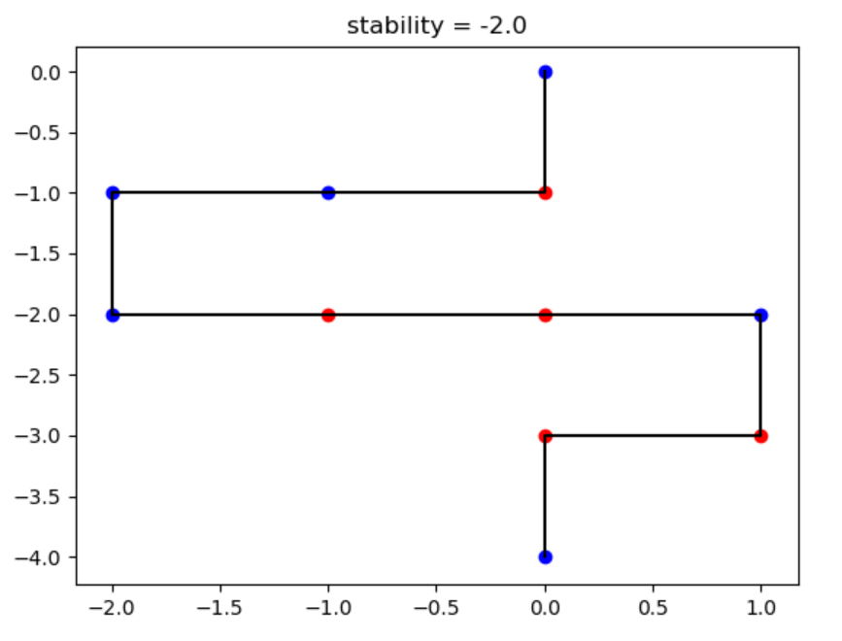
Using a Dictionairy
Key: element nr
Holds list element:
[nr, type, x-coord, y-coord, direction]

Slide 8
Questions and comments?
Our questions:
Best method for storing our data structures
How to prevent a protein ‘folding onto itself’
Thank you for your attention

